Slide 1
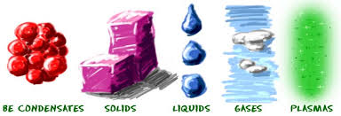
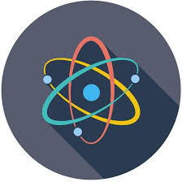
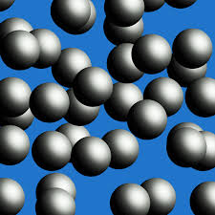
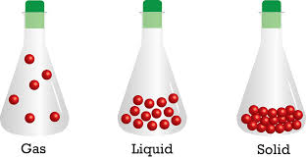
Matter Presentation
By Shant Bolat

Slide 2
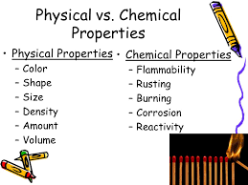

What is Matter?
What is matter? Matter is basically any material or substance that contains mass and volume. It is everywhere and includes substances such as water, the atmosphere, you, your chair etc. Matter is made up of atoms and in those atoms there are little particles called protons, neutrons, and electrons. The protons and neutrons are at the center of the atom while the electrons rotate around them.
Matter also can be in properties. Properties are a way to classify matter. There are two types of properties: Physical and Chemical. Physical properties are properties in matter that you can physically see. Describing a sponge: yellow, not dense, and is able to absorb. Those are all Physical properties. Now chemical properties are very similar to physical properties except it has to do with the chemical makeup of the substance. For example cake has a chemical property where it when it reacts to an oven (intense heat) it rises up and hardens.

Slide 3
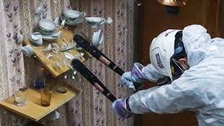
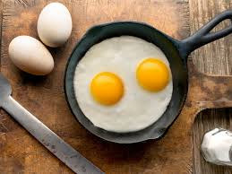
What is Matter? 2
Not only is there different types of properties but there are also physical and chemical changes. A physical change (which is very similar to a chemical change) is a change from the physical look of a material. An example of a physical change is crushing a soda can. Nothing happened to the can the only thing different is the look (its crushed). However chemical changes are different, just like chemical property a chemical change is a change to a substance’s chemical compound. Burning wood for example is a chemical change because it is being turned into ashes and is releases gas. To know if a change is physical or chemical you can tell by: Color (depends if you paint or a chemical reaction), a change in temperature, or even taste

Slide 4
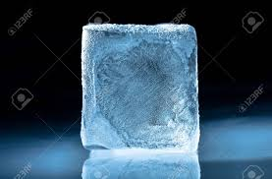
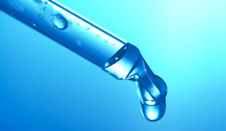
States Of Matter
Most of you people might think that there are 3 states of matter: Solid, liquid and gases. However this is incorrect. There are actually 5 states of matter: Solid,Liquids, Gas, Plasma, and Bose-Einstein. Now to describe them. Solids is a state if matter that is the heaviest. Particles move really slowly, and they have the most mass and volume out of every state. Almost everything you see is a solid. Your desks, pencils, tests, etc are all solids.
Liquids on the other hand are a little bit more complex than solids. There particles are close together but they can move freely. Liquids also can be made into any object (sorta) like solids. You can for example have a cup shapes like a square and when you pour water in it the liquid takes the shape of the cup making it a square.

Slide 5
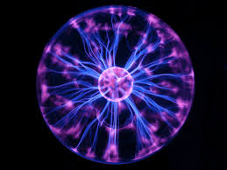
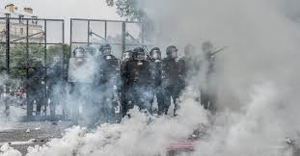
States Of Matter 2
Gases - Gases are everywhere. Their particles are very fast, and they have much room to move. They don't take any shape (like liquids or solids). They also don't really mix. Liquids on one hand are able to be mixed for example water, and coke can be poured together to make an entirely new drink. However Gases can not do this
Plasma - Plasmas are one of the most underrated states of matter. No one teaches you them but there in fact everywhere as well and are just as important as liquids, gases, and solids. Plasma is made when molecule are heated to a couple thousands degrees. The particles move extremely fast. Yet the reason why I call plasmas the most underrated state of matter is the fact that 99.999% of the ENTIRE Universe is made of Plasmas. Its crazy but when you think about it it is true. Stars, planets etc are just giant circles of Plasmas. Not only that but there is plasma on Earth. A tail of a comet for example is a plasma, so is thunder.

Slide 6
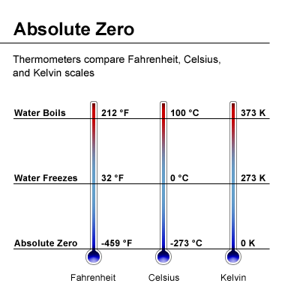
States of Matter 3
Bose-Einstein - Bose-Einstein is a very weird state of matter. It is a state of matter in which molecules are cooled to Absolute Zero. Absolute Zero is impossible to reach but scientists try to get as close as they possibly can. When atoms are this cold they begin to get so tight and jammed together. They cant move and they begin to stop. They become to close that they turn into “1 single molecule”. This state of matter is still being studied as there still isn't too much known about it. Even though Bose-Einstein is a state of matter nearly nothing is a Bose-Einstein because of the fact that nothing can be absolute zero.
Now depending the temperature the faster or slower molecules move. The hotter the temperature the faster the molecules move and the colder it is the slower they move.

Slide 7
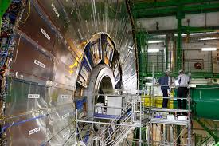
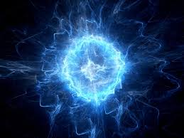
Antimatter
Incase you didn't know there is more than one type of matter. There are three types of matter: normal matter, antimatter, and dark matter. All are very different and for the most part we hardly know anything about the other two types of matter. Anyways antimatter is the exact opposite of normal matter (as the name suggests). It is made of positrons and antiprotons. Antimatter is the most expensive substance in the world. Jade for example (the 2nd most expensive substance) is $170 million dollars but this is nothing compared to Antimatter. Antimatter is worth about 62.5 trillion dollars for 1 gram. Yes 62.5 trillion. World War 2 for example costed $4 trillion dollars in damages. To make this even crazier Amazon is worth over a trillion dollars which means 1 gram of Antimatter is worth 60x more than Amazon. However, cost isn't the only cool fact about Antimatter. Antimatter also destroys normal matter when they touch creating a massive explosion. Antimatter can be used as bombs and only a few grams of it can be powerful enough to destroy massive amounts of land. Antimatter is also being created as we speak. Machines in Sweden called CERN are able to make antimatter but the process is extremely slow.

Slide 8
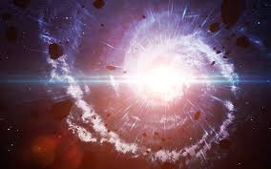
Antimatter 2
Making grams of Antimatter would take millions if not billions of years to make. However I want you to think of something. If we were able to make grams and grams of antimatter how would we store it? Think about it everything Antimatter touches blows up and the fact that only a few grams can destroy cities storing it has to be extremely careful.
Once final fact that I wanna tell you about antimatter is that when the Big Bang happened it was suppose to make equal amounts of antimatter and normal matter. But this isn't true at all obviously and this still remains one of the biggest mysteries of the entire universe.

Slide 9
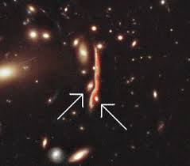
Dark Matter
Dark Matter is something we don't know at all and the more we learn about it the more questions there are. Dark Matter is basically matter that is found primarily in space. It is invisible even if you shined light at it. Unlike antimatter Dark Matter doesn't explode or even react with normal matter. However what weedo know about Dark Matter is that it bends light in space and also makes about 27% of matter in the universe. And that's all we know about Dark Matter. Dark Matter is the most difficulty and least known of the 3. Dark Matter is also one of the biggest questions about physics (just like antimatter).

